Slide 1
Databases
Lecture 1
Introduction

Slide 2
About the course
about 15 lectures and practical lessons
3 tests (blocking)
5 homeworks
quizzes
project (blocking)
differential mark
Grade:
0.1 * (sum of quizzes) + 0.2 * (sum of tests) + 0.2 * (sum of HW) + 0.5 * (project) + 0.2 * (final test) + 0.1*(bonus)

Slide 3
Database
a set of data stored in accordance with the data schema, which is manipulated in accordance with the rules of data modeling tools
a collection of data organized according to a conceptual structure describing the characteristics of this data and the relationships between them, and such a collection of data that supports one or more application areas

Slide 4

Why we need databases
storage and processing of a large amount of information
data sharing

Slide 5
Data Models
Hierarchical data model
Network Data Model
Relational data model

Slide 6
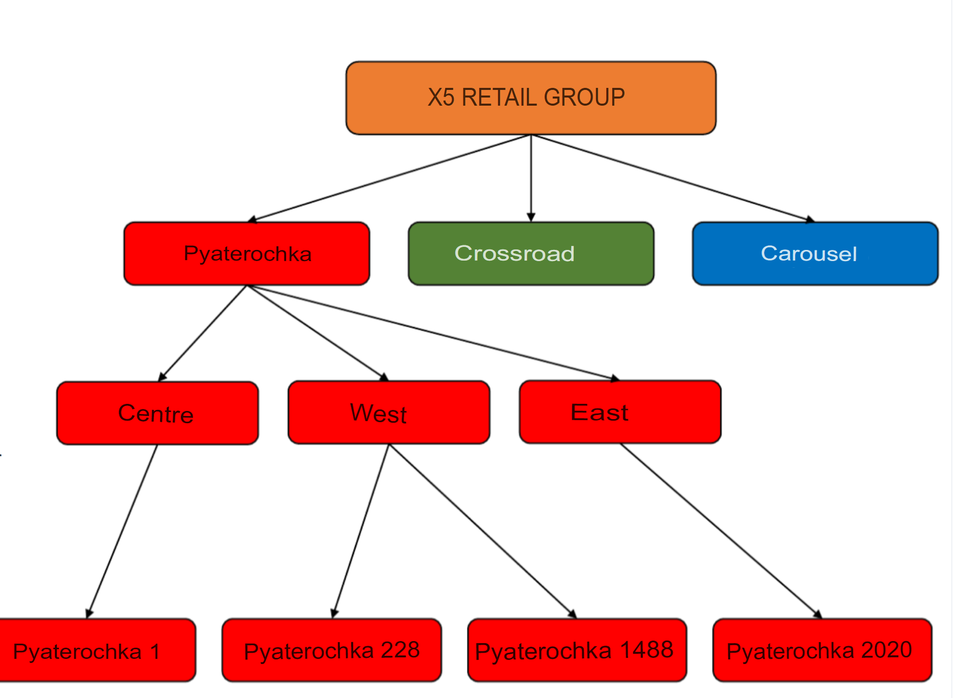
Hierarchical data model
IBM, 1960s
Tree structure of records
A descendant has exactly 1 ancestor
Descendants of a common ancestor –twins

Slide 7
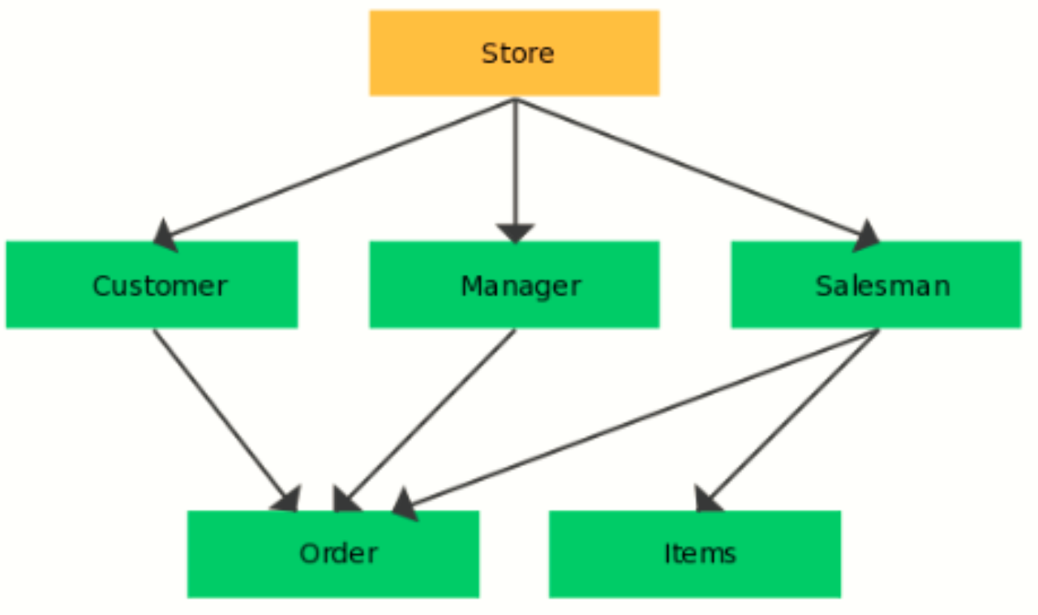
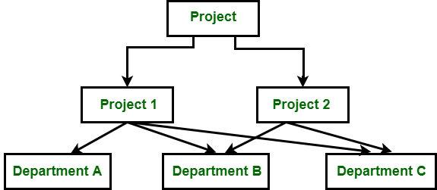
Network data model
Charles Bachman, 1969
The structure of records in the form of a graph
Extends the hierarchical data model
A descendant can have more than 1 ancestor

Slide 8


Disadvantages
High complexity and rigidity of DB schema
Lack of flexibility
Performing even simple queries is a complex process
Dependence on physical data organizations
Low efficiency

Slide 9

Relational data model
1969-1970 E. Codd
June 1970 "A Relational Model of Data for
Large Shared Data Banks"
The model is based on mathematics and logic
Logical data model
Does not depend on physical structures

Slide 10
Basic concepts
A domain is a set of valid values.
The attribute is the name of the domain.
A tuple is an ordered set of fixed length.
The Cartesian product (of sets A = (a1, a2,...) and B = (b1, b2,...)) is the set of pairs: A B = {(a,b): a ∈ A & b ∈ B}.
The arity of a relation is the number of its elements (the number of attributes).

Slide 11
Example: relation
relation
ID | FIRST_NM | LAST_NM | PHONE_NO | CREATE_DT
1 | Ivan | Ivanov | 79039065432 | 2017-08-12
101 | Sergey | Serov | 79612345623 | 2003-05-14
1006 | Piotr | Petrov | 79013724683 | 2018-06-24
70009 | Nikolay | Sidorov | 79262345401 | 2013-12-16

Slide 12
Example
header of relation
ID | FIRST_NM | LAST_NM | PHONE_NO | CREATE_DT
1 | Ivan | Ivanov | 79039065432 | 2017-08-12
101 | Sergey | Serov | 79612345623 | 2003-05-14
1006 | Piotr | Petrov | 79013724683 | 2018-06-24
70009 | Nikolay | Sidorov | 79262345401 | 2013-12-16
tuple

Slide 13
Example
ID | FIRST_NM | LAST_NM | PHONE_NO | CREATE_DT
1 | Ivan | Ivanov | 79039065432 | 2017-08-12
101 | Sergey | Serov | 79612345623 | 2003-05-14
1006 | Piotr | Petrov | 79013724683 | 2018-06-24
70009 | Nikolay | Sidorov | 79262345401 | 2013-12-16
domain: natural numbers

Slide 14
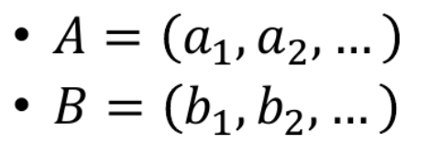
Cartesian product
A and B are sets
The Cartesian product of sets A and B is the set of pairs:

Slide 15
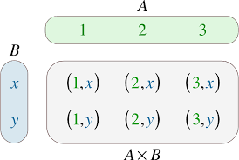
Cartesian product

Slide 16

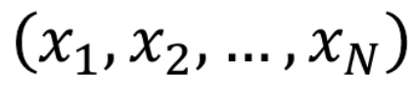
Extended cartesian product
We have N sets, where N > 1
An extended Cartesian product of N sets is a set of the form:
An element of such a set is called a tuple.

Slide 17
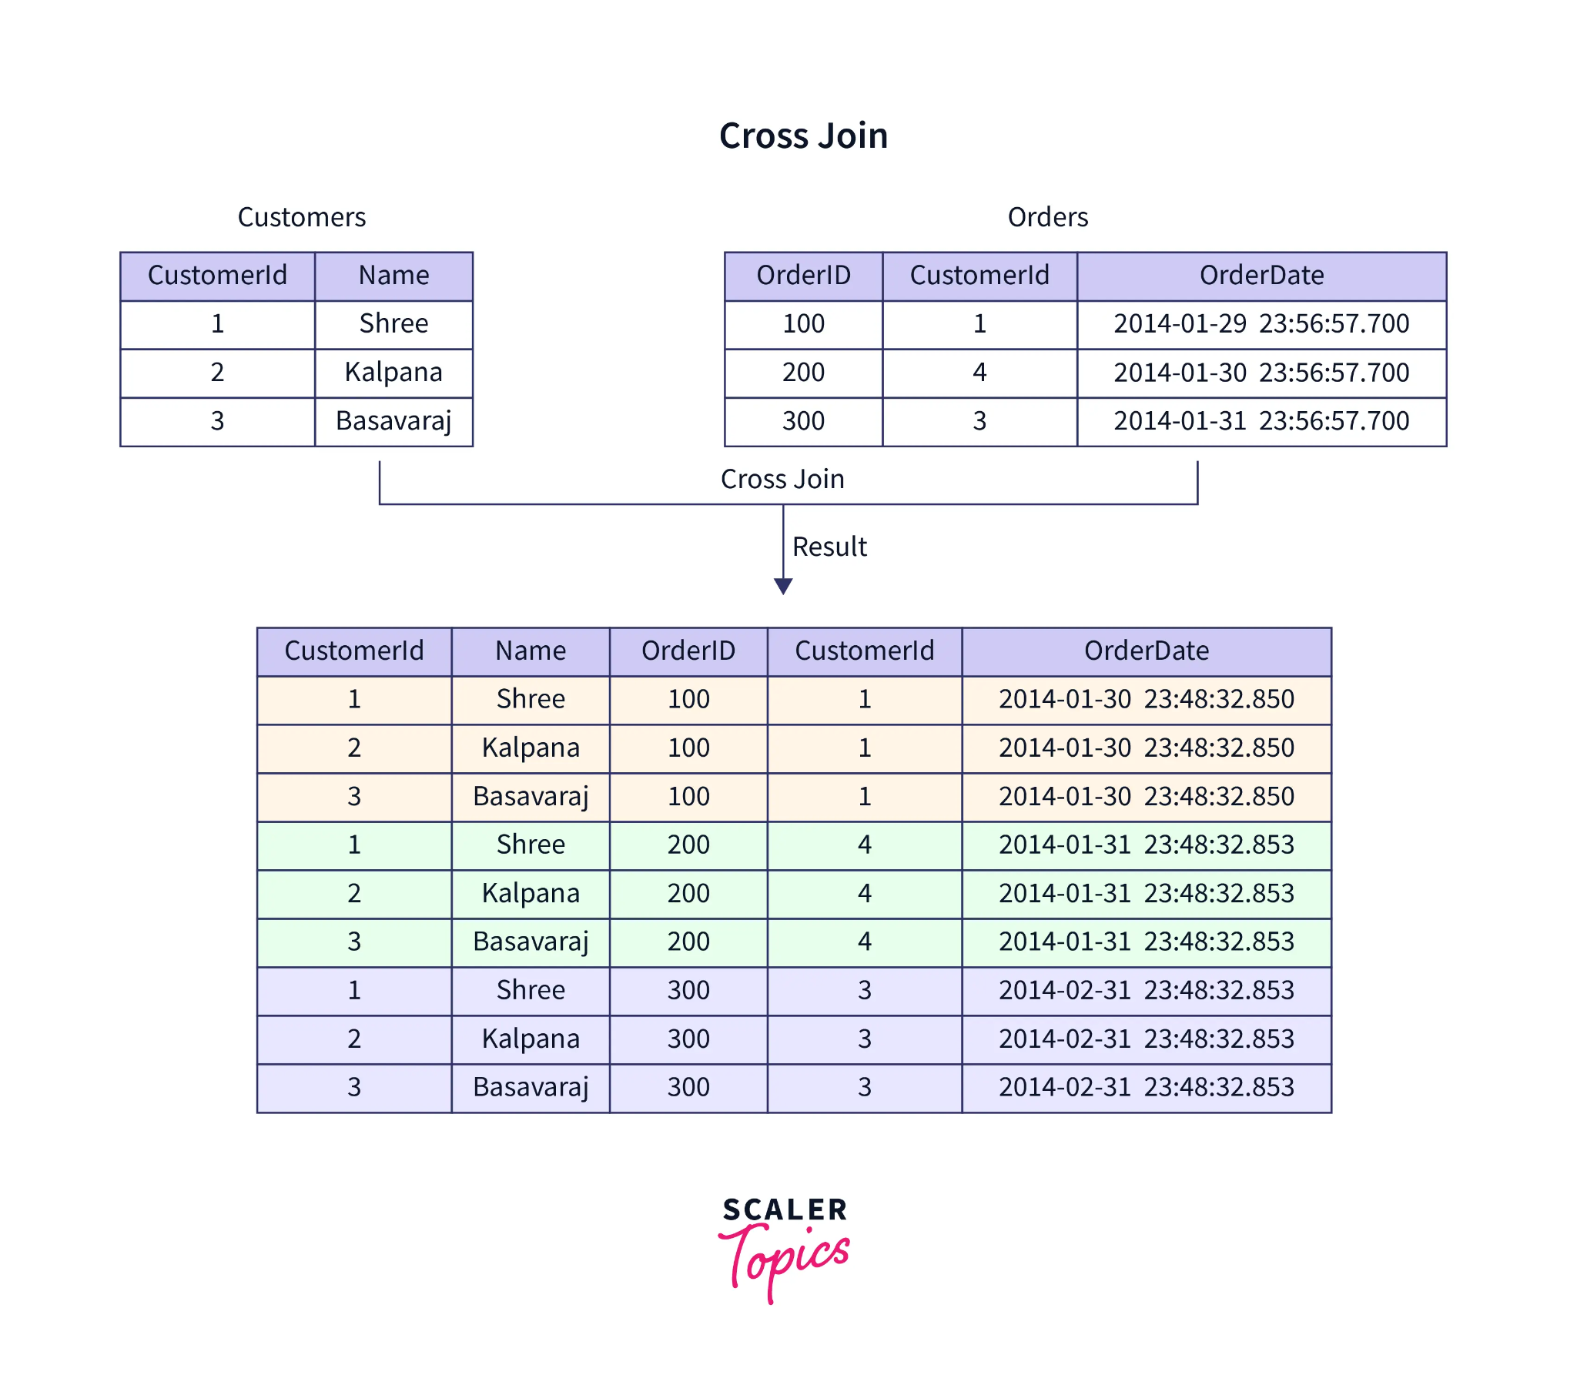
Extended Cartesian product
Q
R
Q x R = Z

Slide 18
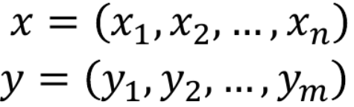
Coupling of tuples
x and y are tuples
Then the coupling of tuples x and y will be a tuple of dimension n + m:

Slide 19


Basic concepts
Domains
A list of attributes is given, so that each domain D_i corresponds to an attribute A_i defined on this domain.
Then by the relation defined on attributes (domains) is a subset of the extended Cartesian product of these domains:

Slide 20
Basic concepts
The arity of a relationship is the number of attributes.
Relationship title – a list of attributes.
The set of tuples that make up the relationship is the body of the relationship.
A domain is called composite if it is an extended Cartesian product of a finite number of simple domains.
We will say that two simple domains 1 and 2 are compatible if they either coincide, or 2⊆ 1 or 2 ⊆ 1

Slide 21
Relationship Properties
No two tuples are the same;
The order of tuples is not defined;
The order of attributes is not defined.

Slide 22
Example of a relational data model
Relationship. In general, the table is not a relation. Why?
ID | FIRST_NM | LAST_NM | PHONE_NO | CREATE_DT
1 | Ivan | Ivanov | 79039065432 | 2017-08-12
101 | Sergey | Serov | 79612345623 | 2003-05-14
1006 | Piotr | Petrov | 79013724683 | 2018-06-24
70009 | Nikolay | Sidorov | 79262345401 | 2013-12-16

Slide 23






Relational algebra
A family of subsets of a set X (the carrier of an algebra) is called an algebra if it satisfies the following properties:
If then
If then
Relational algebra:
Carrier – a set of (all possible) relations of various (finite) orders

Slide 24
Set-theoretic operations
Applicable to compatible relationships:
Association
Difference
Intersection
Hereafter Cartesian product == extended Cartesian product, unless otherwise specified

Slide 25

Relational operations: limitation
Construction of a new relationship, which includes tuples that satisfy a given condition.
R – the specified ratio,
A and B – lists of attribute identifiers,
Problem: it is permissible only to compare the values of (composite) attributes within the same tuple

Slide 26
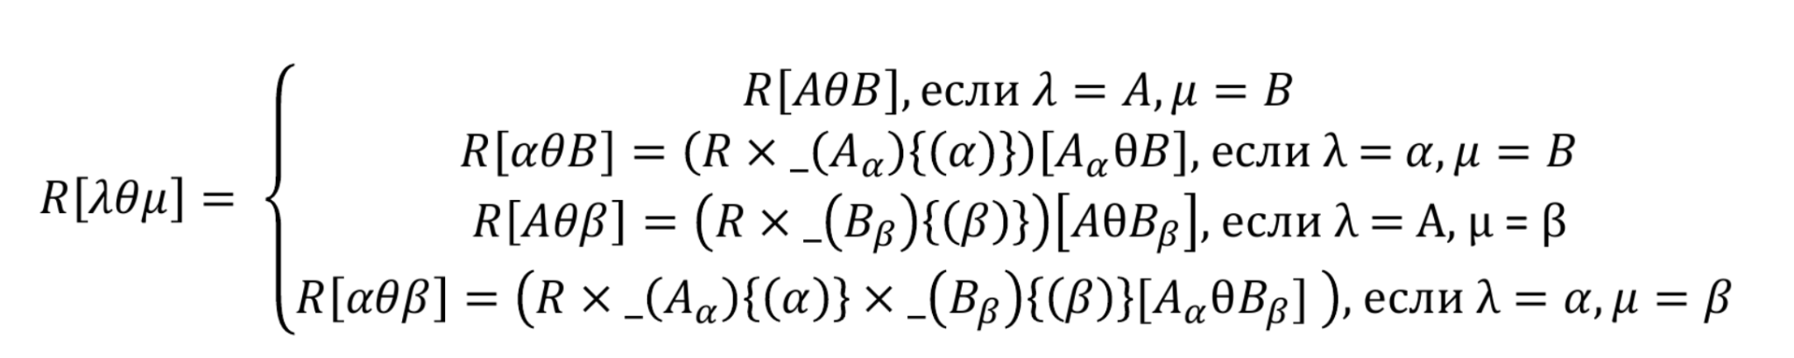
Relational operations: limitation
if
if
if
if

Slide 27
person_name | score_amt
Ivan | 10
Piotr | 3
Nikolay | 15
Sergey | 20
Ilia | 0
Anna | 5
Maxim | 30
Dmitry | 7
Q = R[score_amt ≥ 15]

Slide 28
person_name | score_amt
Ivan | 10
Piotr | 3
Nikolay | 15
Sergey | 20
Ilia | 0
Anna | 5
Maxim | 30
Dmitry | 7
Q = R[score_amt ≥ 15]
person_name | score_amt
Nikolay | 15
Sergey | 20
Maxim | 30

Slide 29

Relational operations: projection
Building a new relationship with a given list of attributes.

Slide 30
first_nm | last_nm | score_amt
Ivan | Ivanov | 10
Piotr | Petrov | 3
Nikolay | Ivanov | 15
Sergey | Serov | 20
Ilia | Ivanov | 0
Anna | Petrova | 5
Maxim | Serov | 30
Dmitry | Petrov | 7
Q = R[last_nm]

Slide 31
Q = R[last_nm]
first_nm | last_nm | score_amt
Ivan | Ivanov | 10
Piotr | Petrov | 3
Nikolay | Ivanov | 15
Sergey | Serov | 20
Ilia | Ivanov | 0
Anna | Petrova | 5
Maxim | Serov | 30
Dmitry | Petrov | 7
last_nm
Ivanov
Petrov
Serov
Petrova

Slide 32

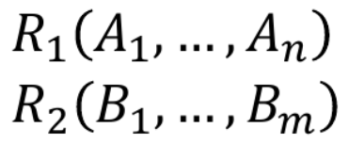
Relational operations: connection
The composition of a Cartesian product of two relations followed by a constraint on a given condition.
relation
relation
As A_i, B_i , you can use attribute lists. Natural connection: removes an extra attribute

Slide 33
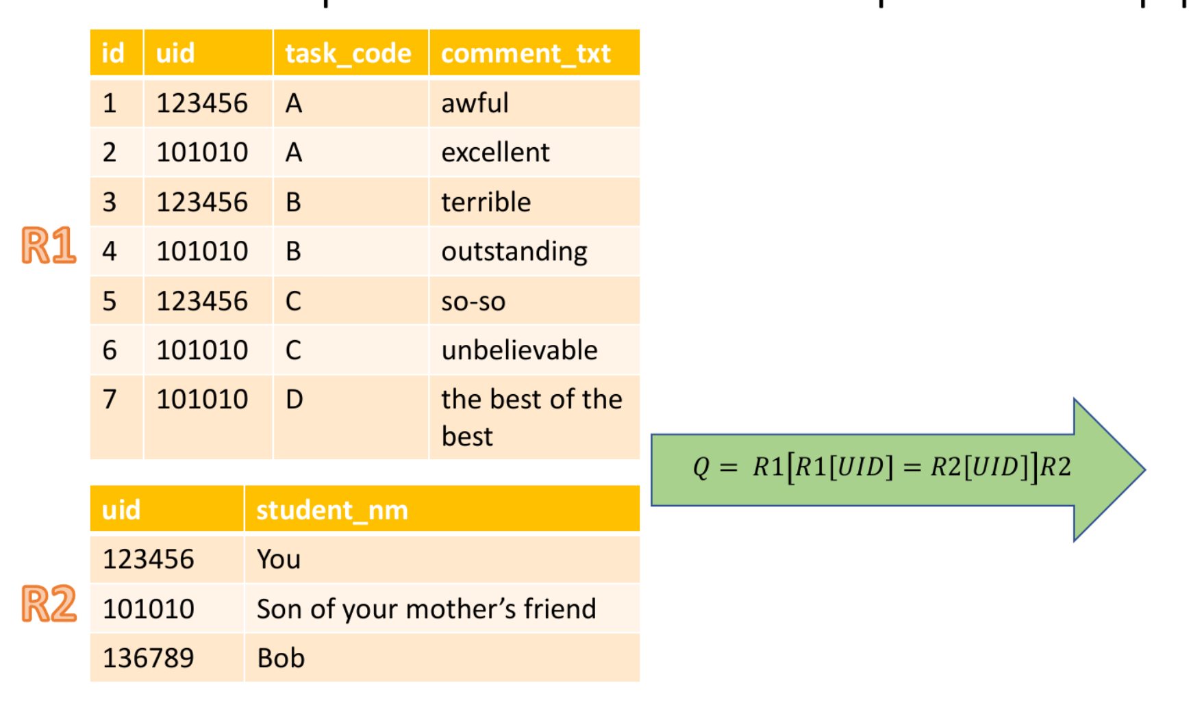
R1
Q = R1[R1[UID] = R2[UID]]R2
R2

Slide 34
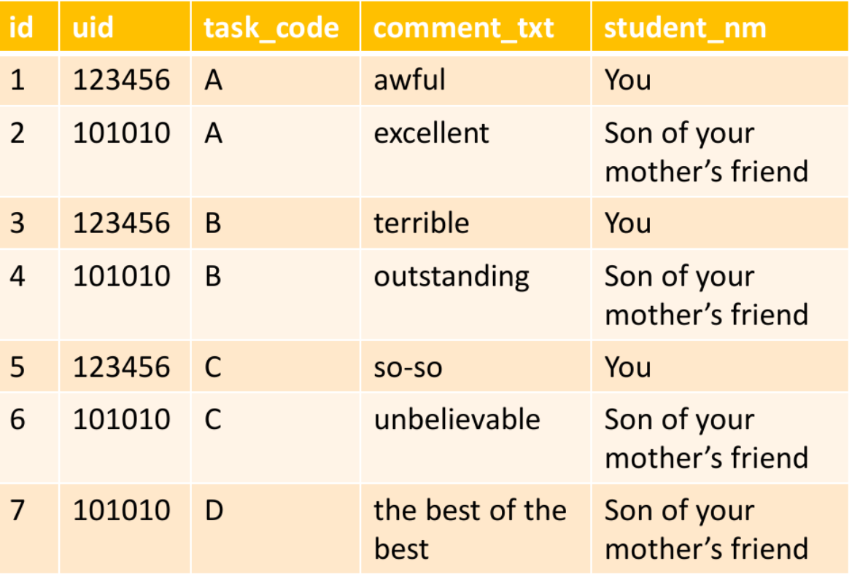
Q = R1[R1[UID] = R2[UID]]R2

Slide 35
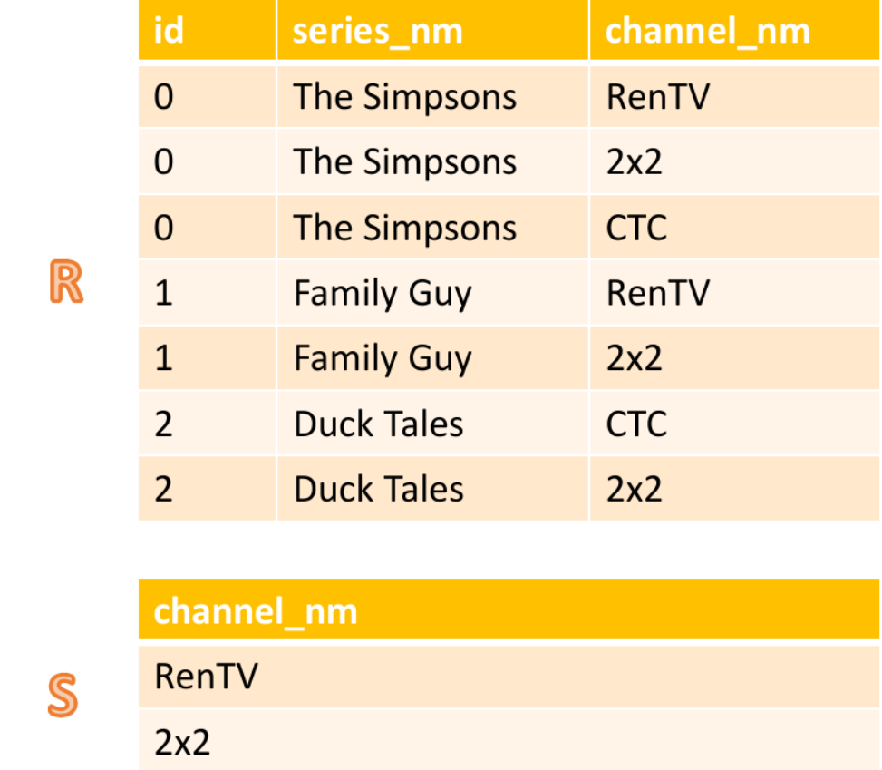
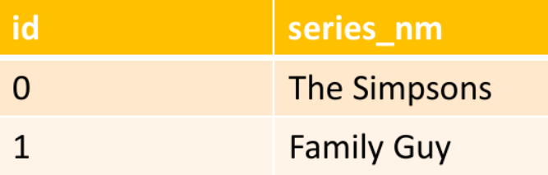
Division
We want to get the series from relation 1,
which were broadcast on all channels
from relation 2
Q = R/S

